Slide 1
AIMS - AUTOMATED INVENTORY MANAGEMENT SYSTEM
USER MANUAL

Slide 2
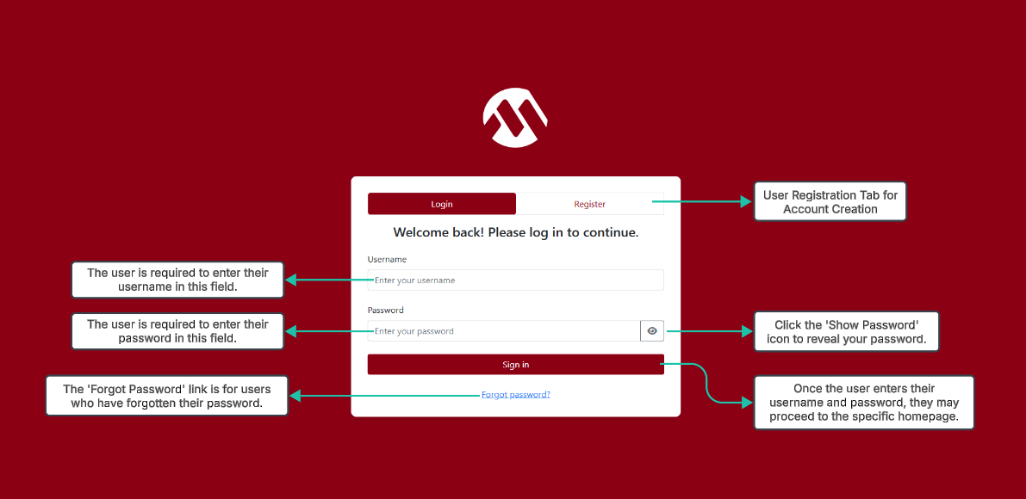
Account Login Tab

Slide 3
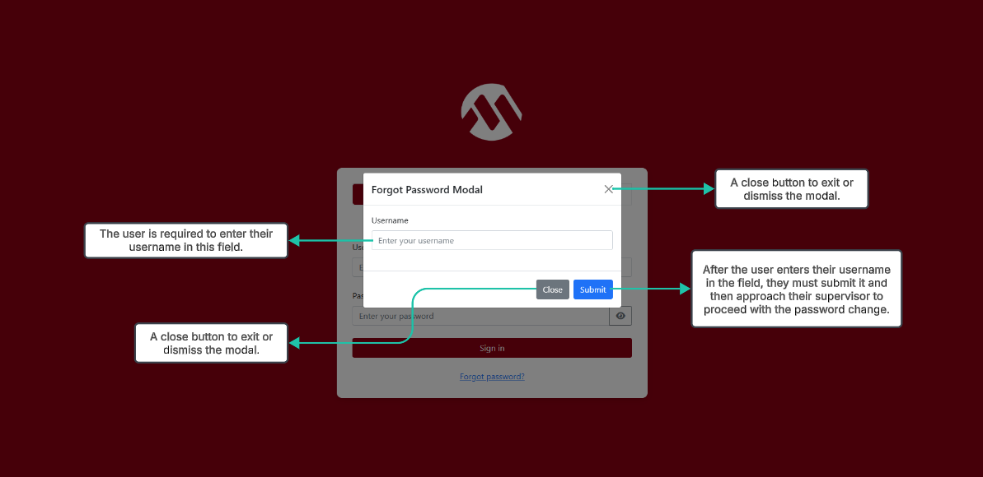
Forgot Password Link

Slide 4
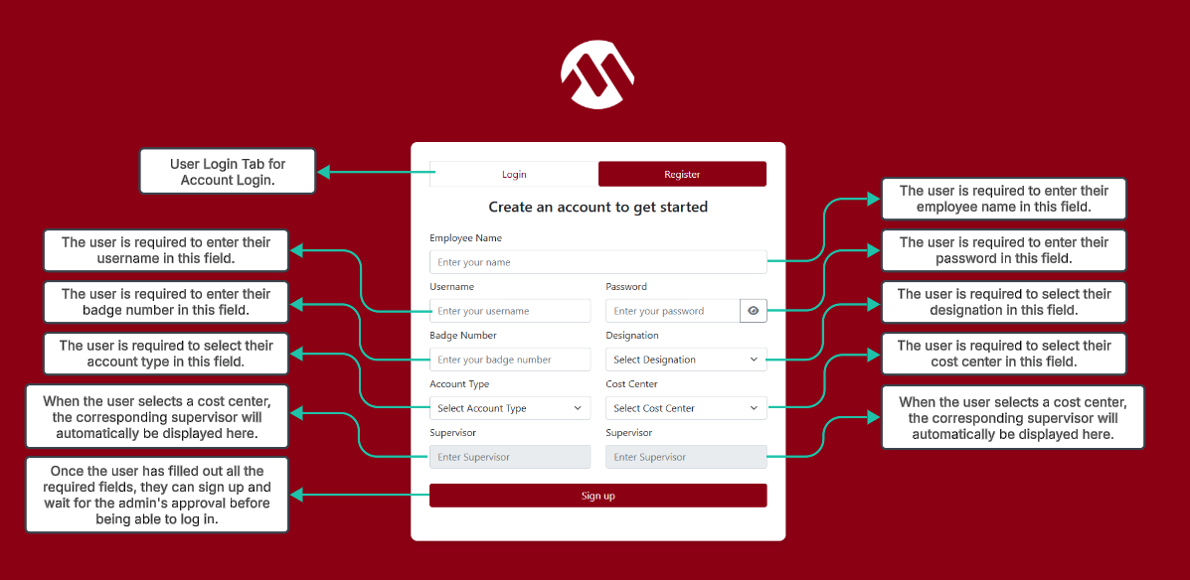
Account Registration Tab

Slide 5
USER MODULE

Slide 6
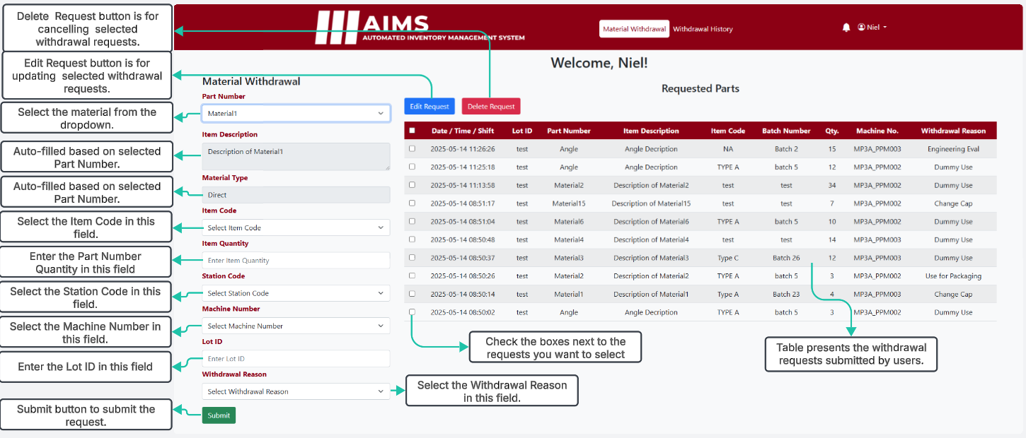
User’s Material Withdrawal

Slide 7
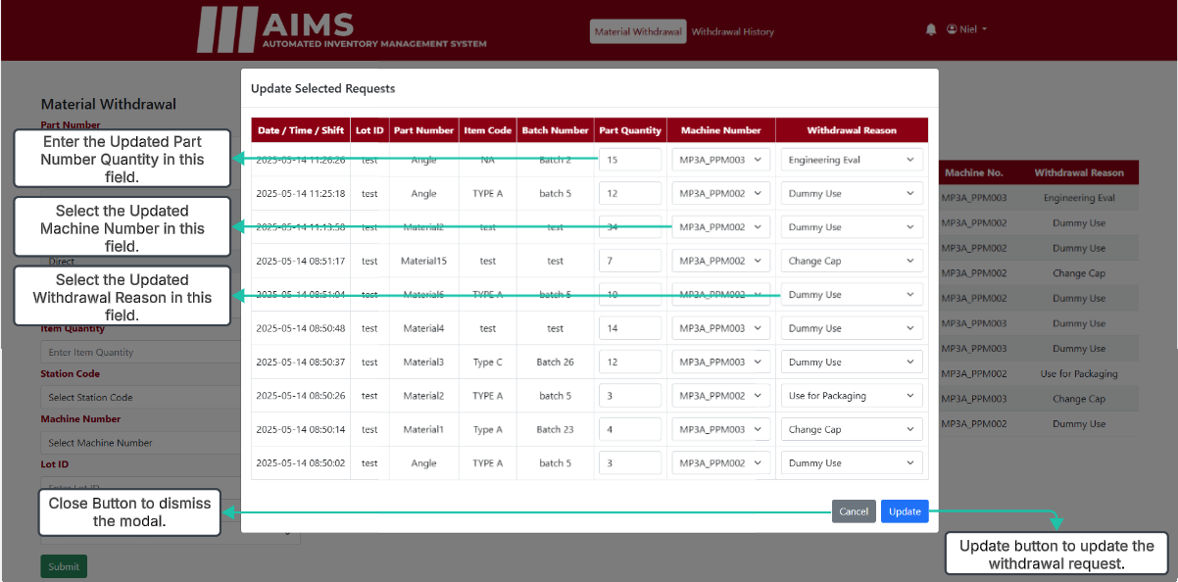
User’s Material Withdrawal (Update Modal)

Slide 8
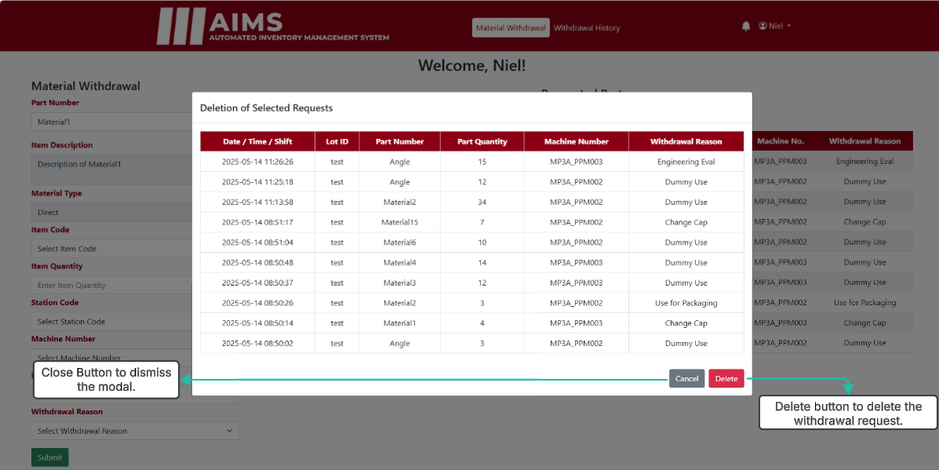
User’s Material Withdrawal (Delete Modal)

Slide 9
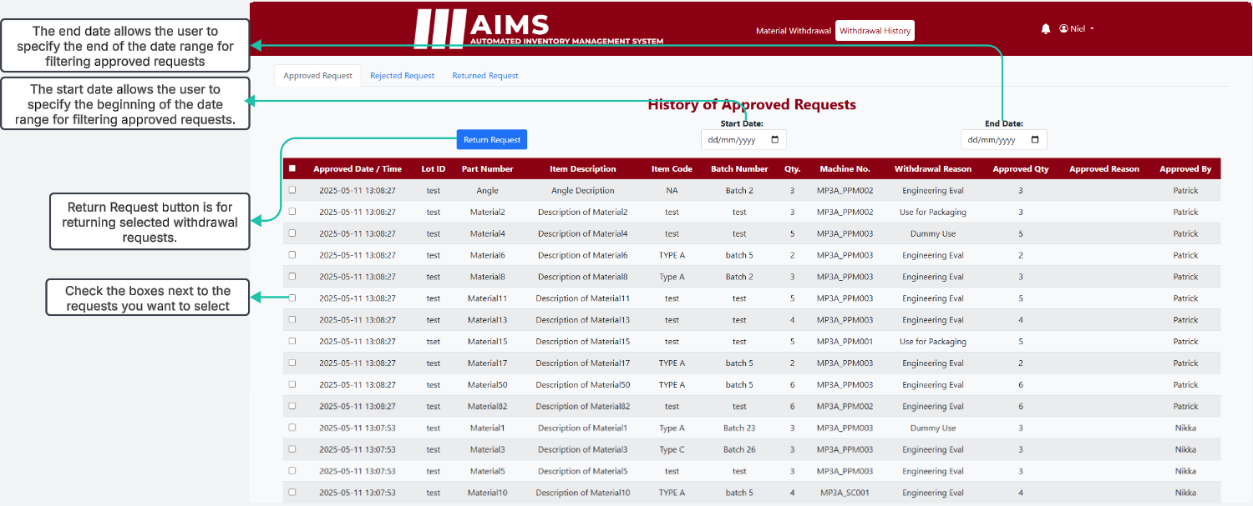
User’s Withdrawal History (Approved Tab)

Slide 10
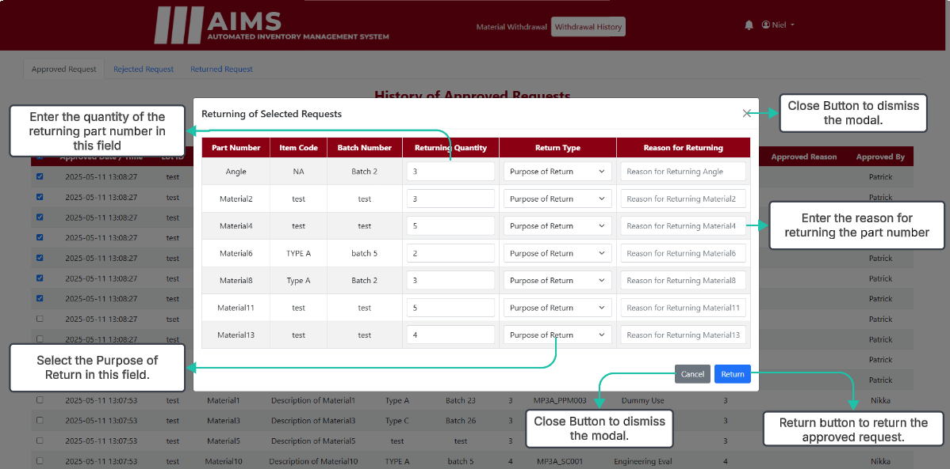
User’s Withdrawal History (Return Modal)

Slide 11
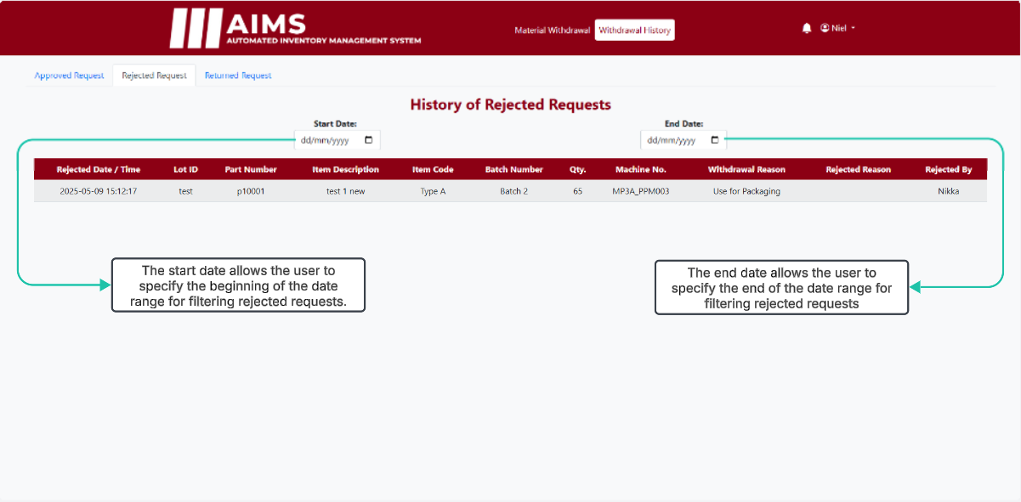
User’s Withdrawal History (Rejected Tab)

Slide 12
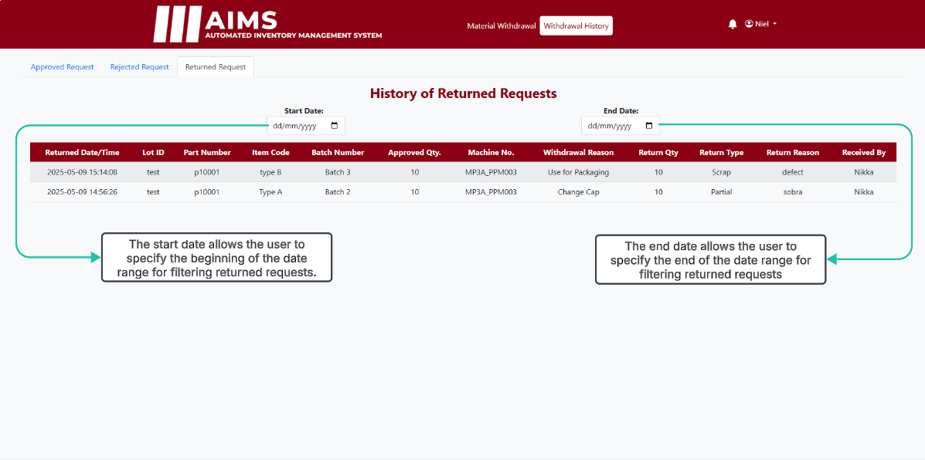
User’s Withdrawal History (Returned Tab)

Slide 13
SUPERVISOR / KITTING MODULE

Slide 14
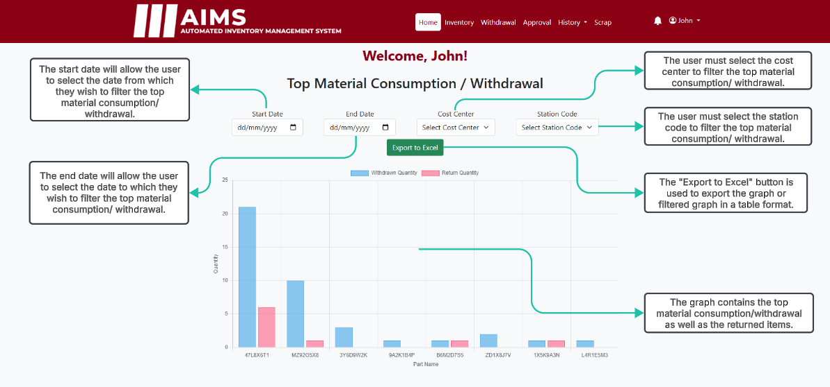
Supervisor / Kitting Dashboard

Slide 15
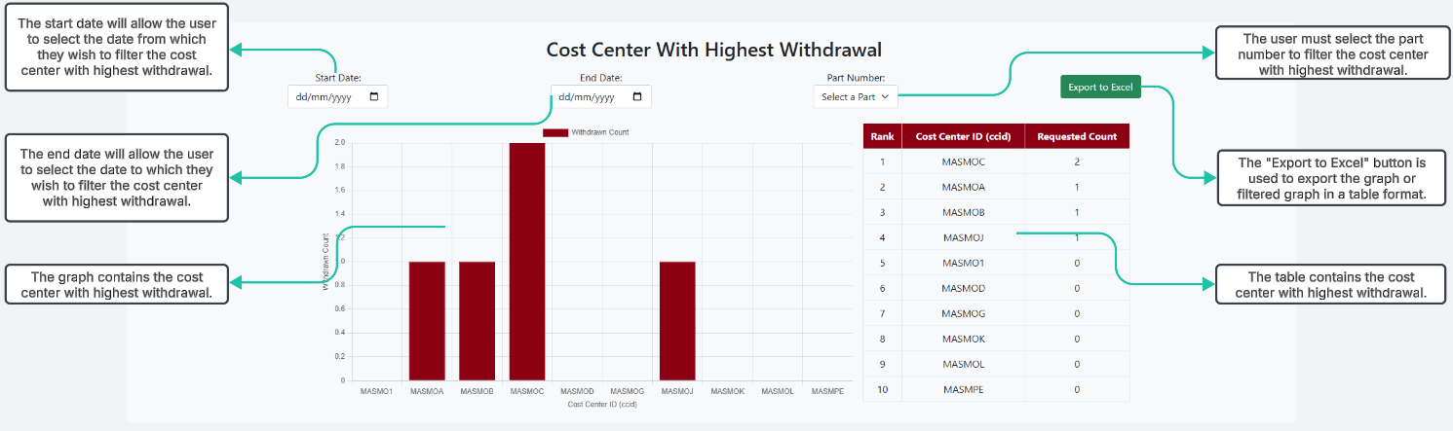
Supervisor / Kitting Dashboard

Slide 16
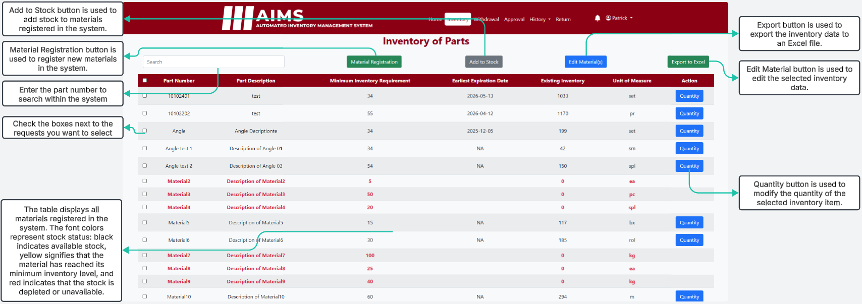
Supervisor / Kitting Inventory

Slide 17
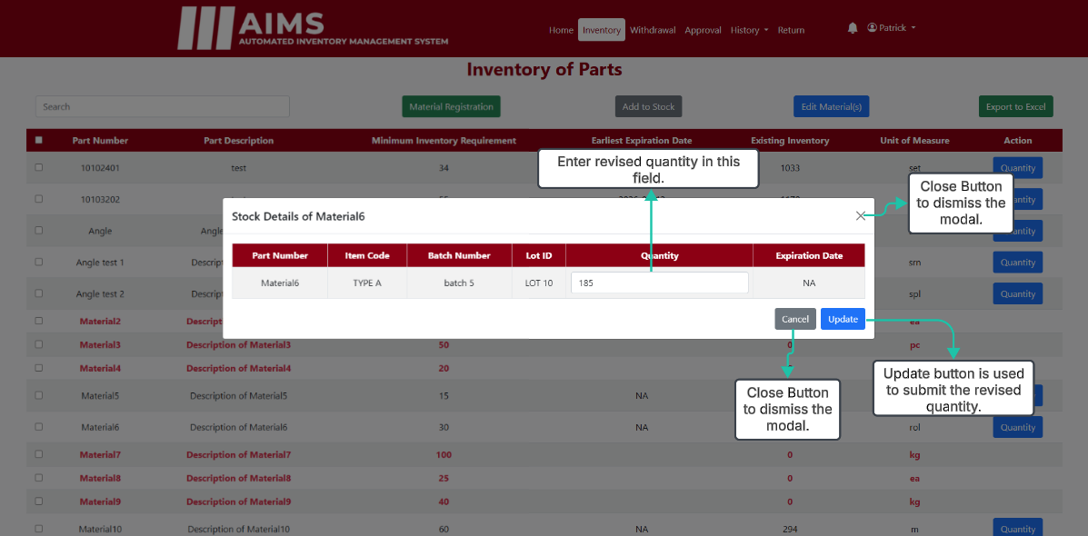
Supervisor / Kitting Inventory (Quantity Button)

Slide 18
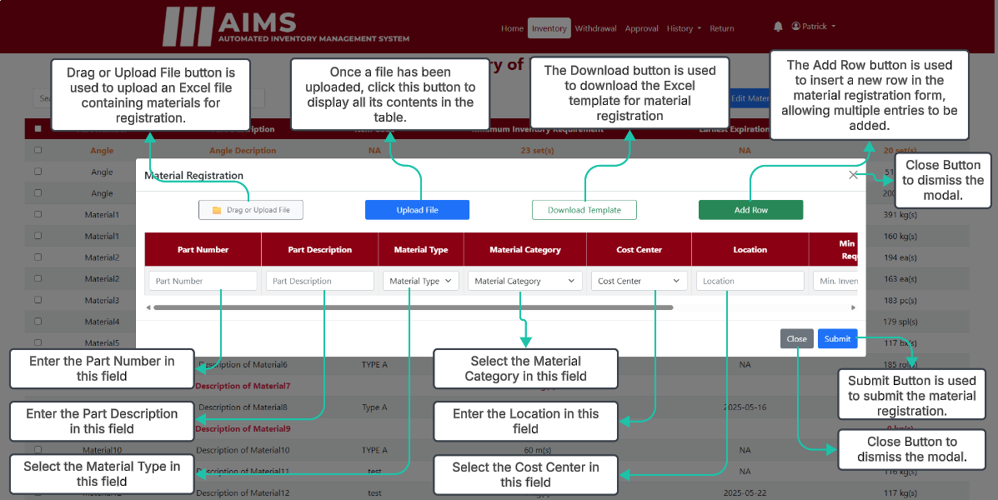
Supervisor / Kitting Inventory (Material Registration)

Slide 19
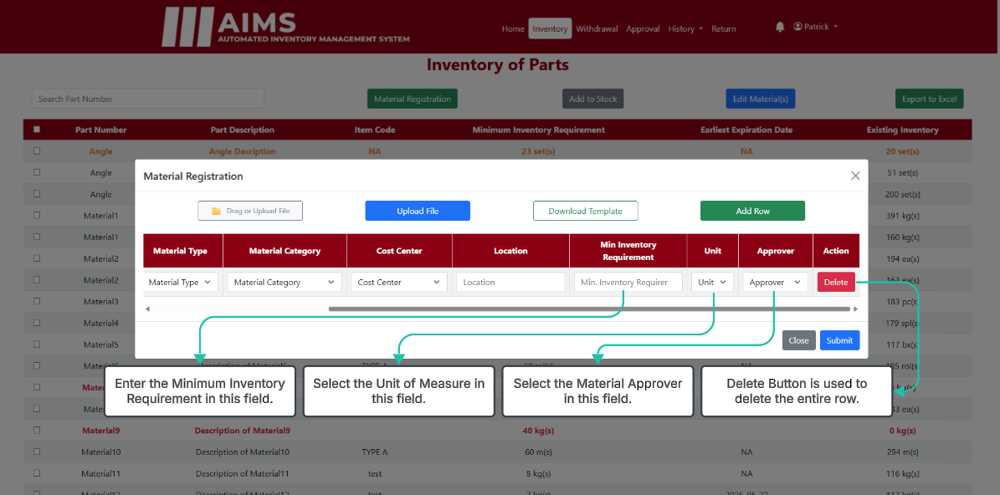
Supervisor / Kitting Inventory (Material Registration)

Slide 20
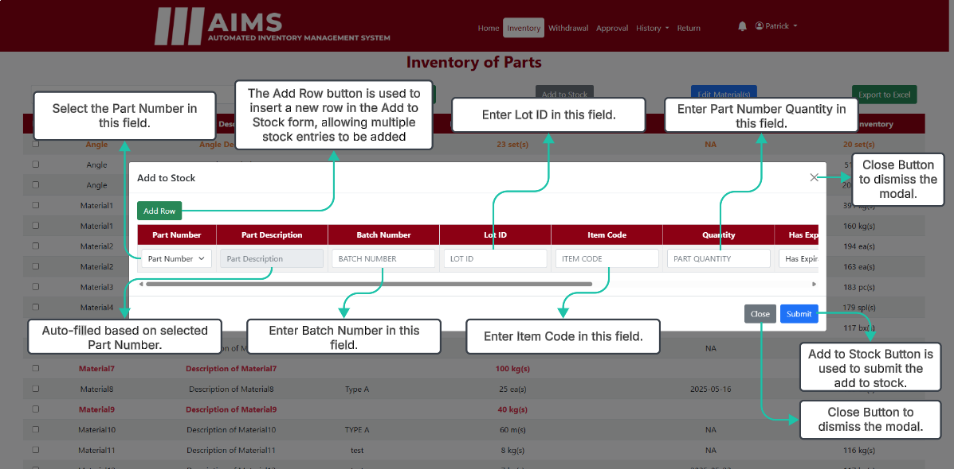
Supervisor / Kitting Inventory (Add to Stock)

Slide 21
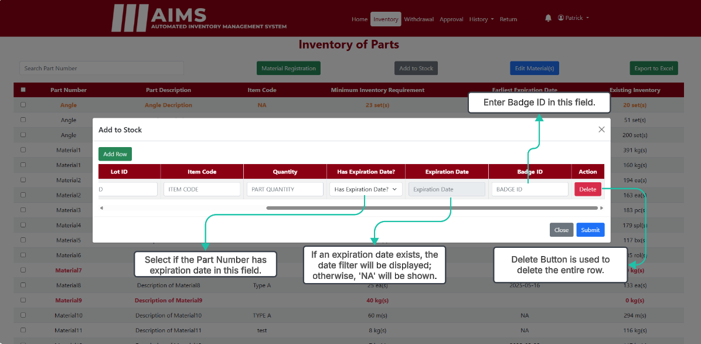
Supervisor / Kitting Inventory (Add to Stock)

Slide 22
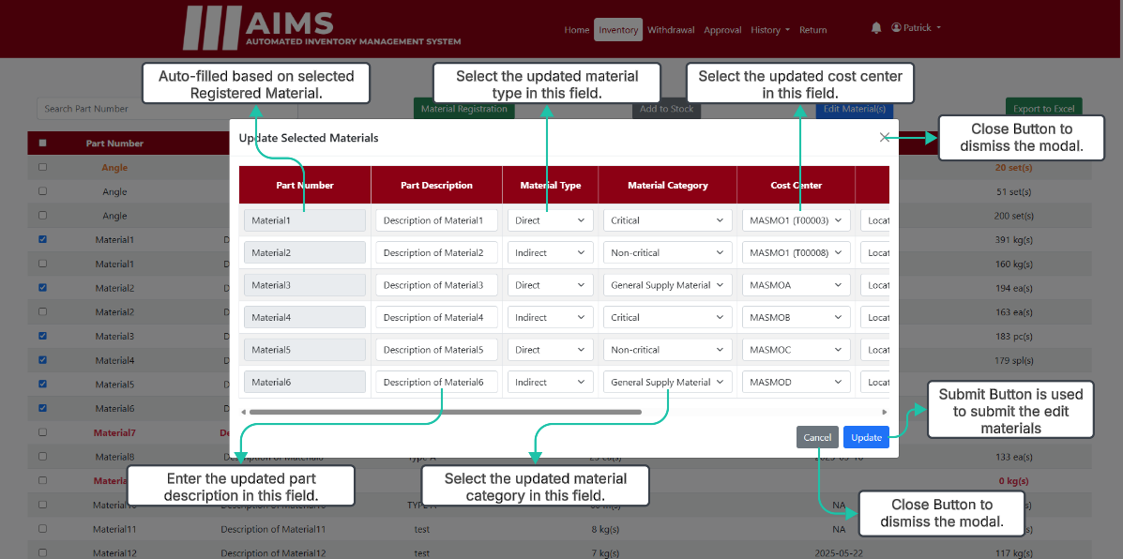
Supervisor / Kitting Inventory (Edit Button)

Slide 23
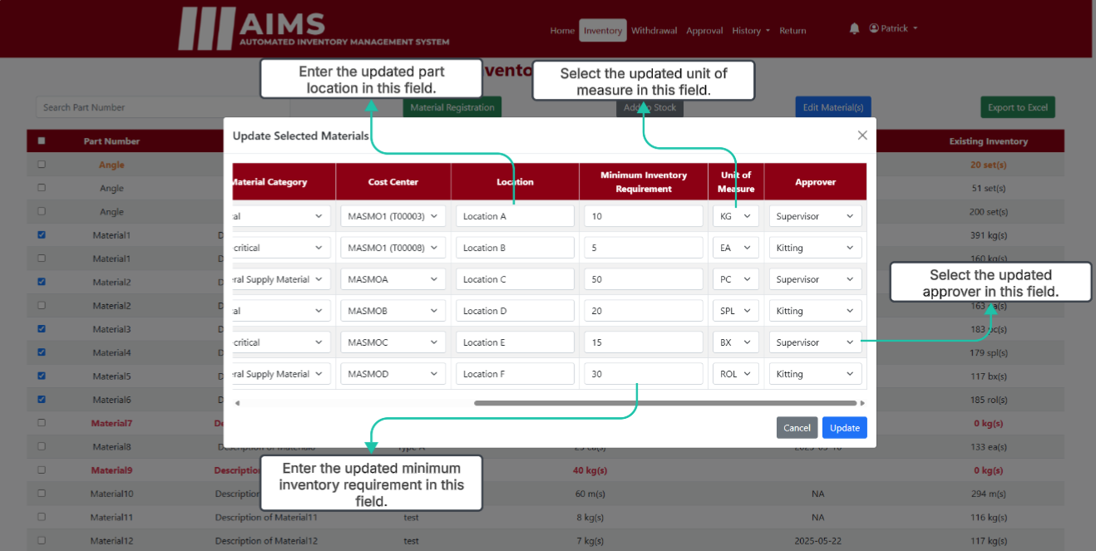
Supervisor / Kitting Inventory (Edit Button)

Slide 24
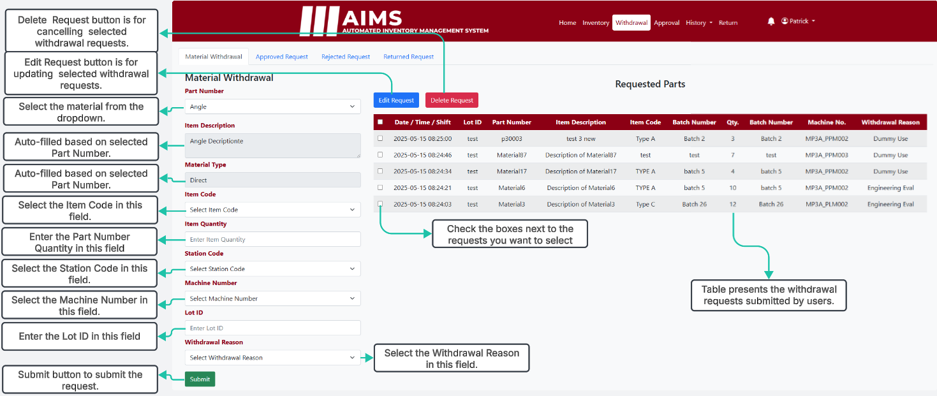
Supervisor / Kitting Material Withdrawal

Slide 25
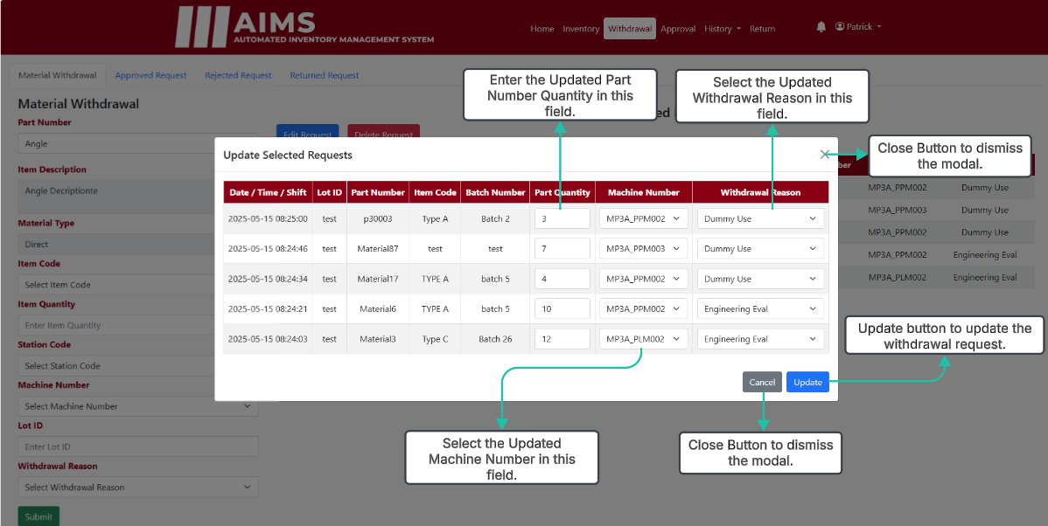
Supervisor / Kitting Material Withdrawal (Edit Modal)

Slide 26
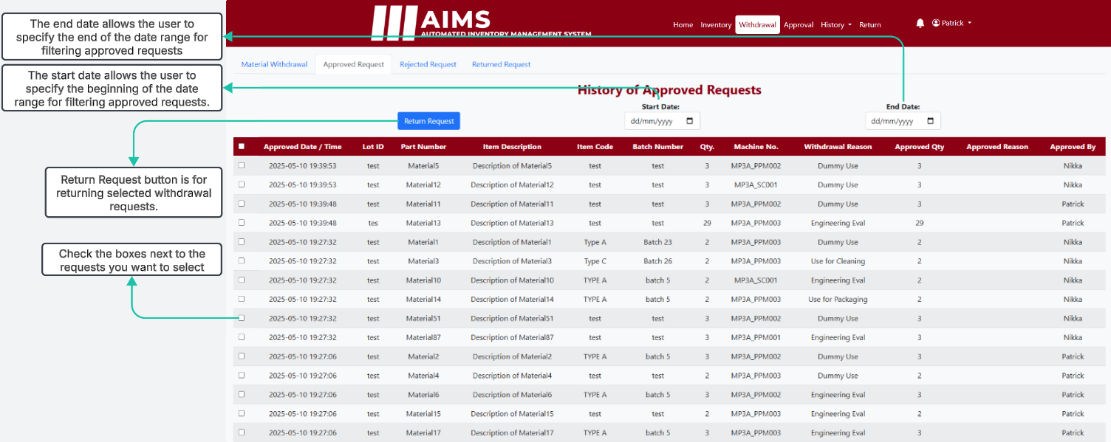
Supervisor / Kitting Approve Request

Slide 27
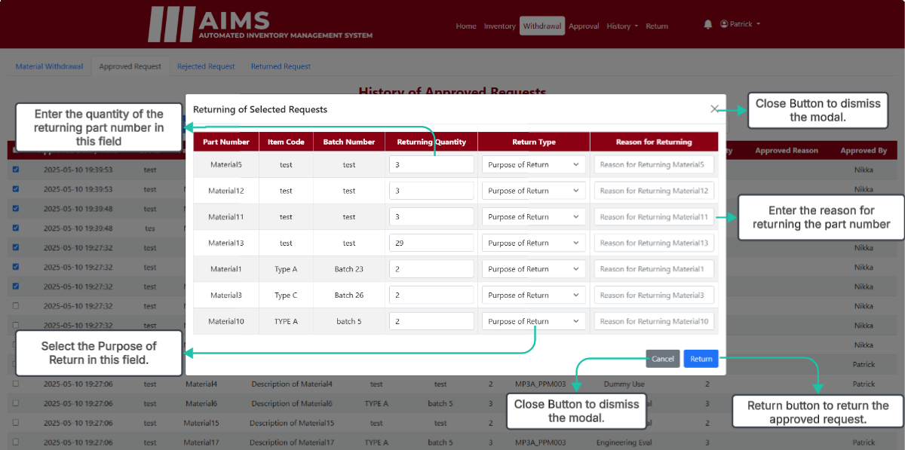
Supervisor / Kitting Return Modal

Slide 28
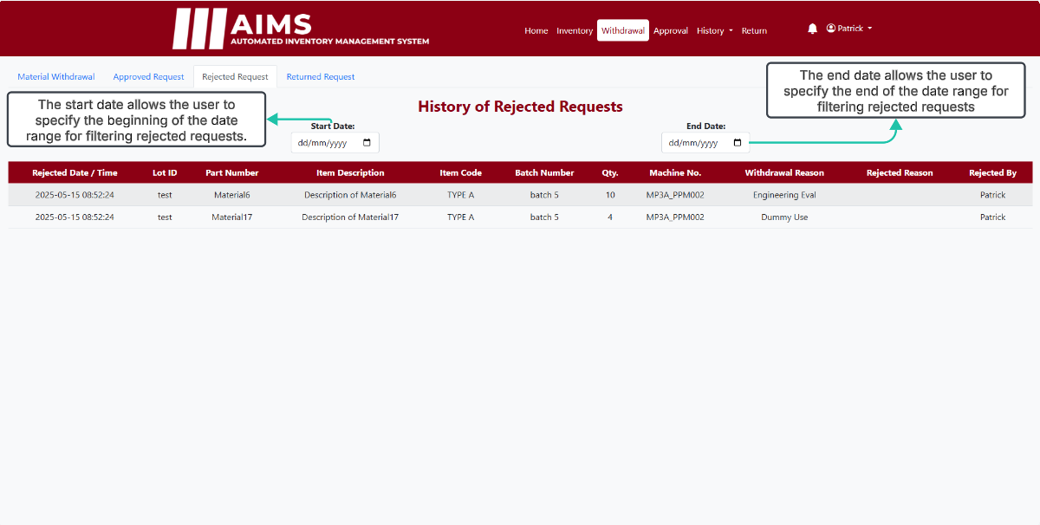
Supervisor / Kitting Reject Request

Slide 29
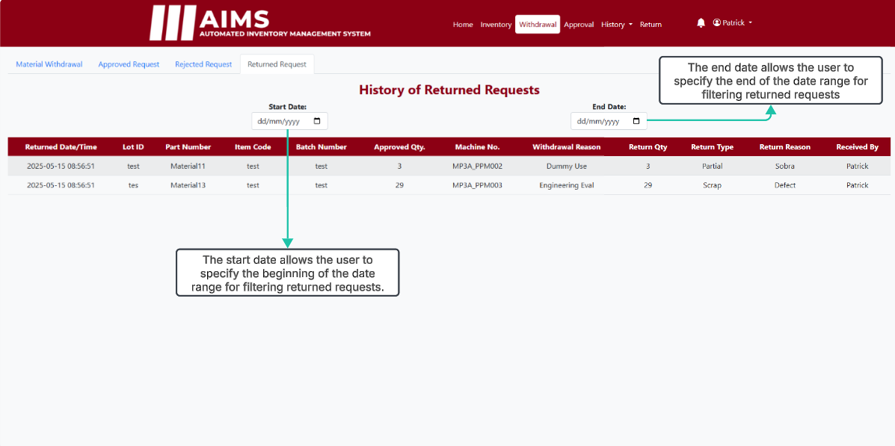
Supervisor / Kitting Return Request

Slide 30
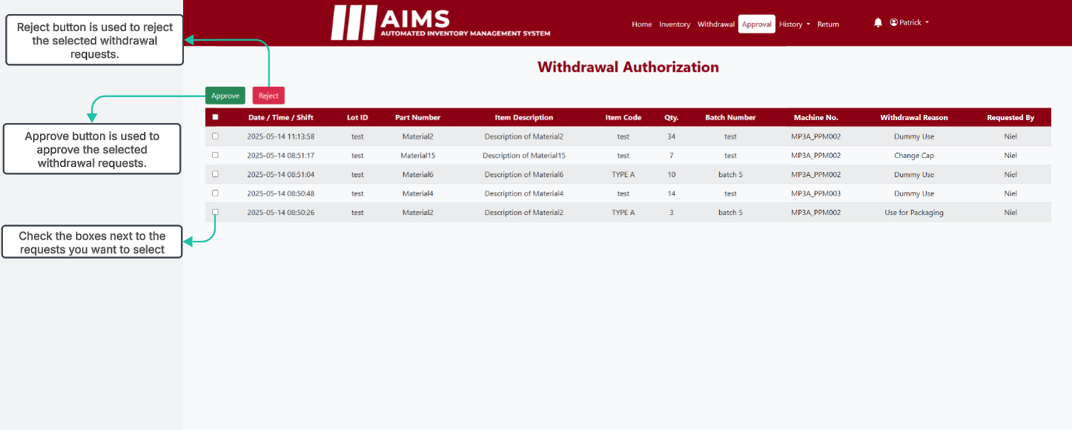
Supervisor / Kitting Approval

Slide 31
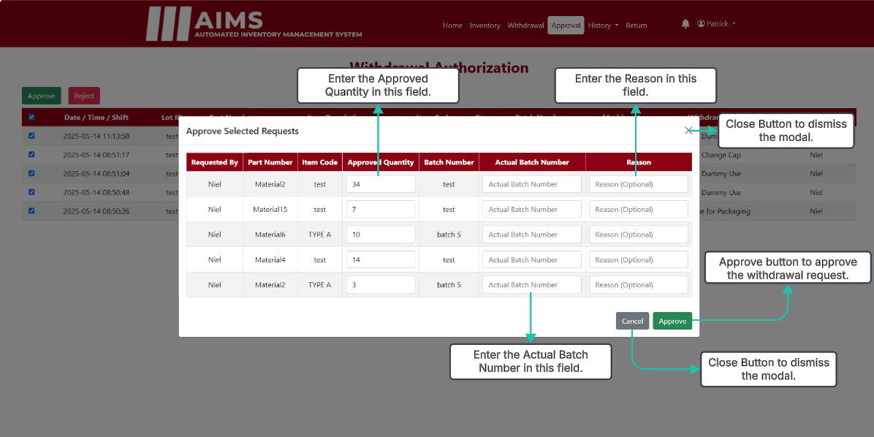
Supervisor / Kitting Approval (Approve Modal)

Slide 32
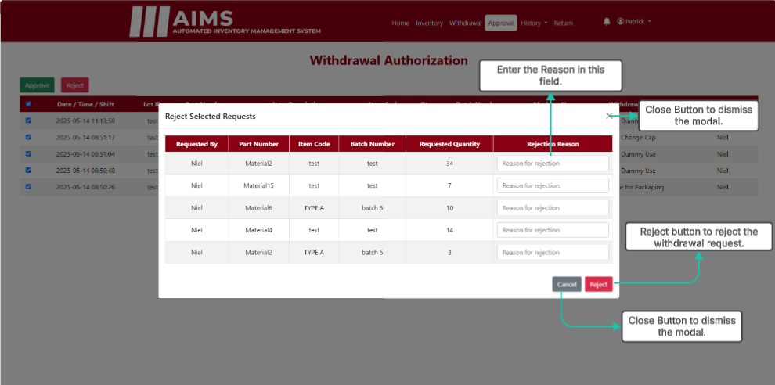
Supervisor / Kitting Approval (Reject Modal)

Slide 33
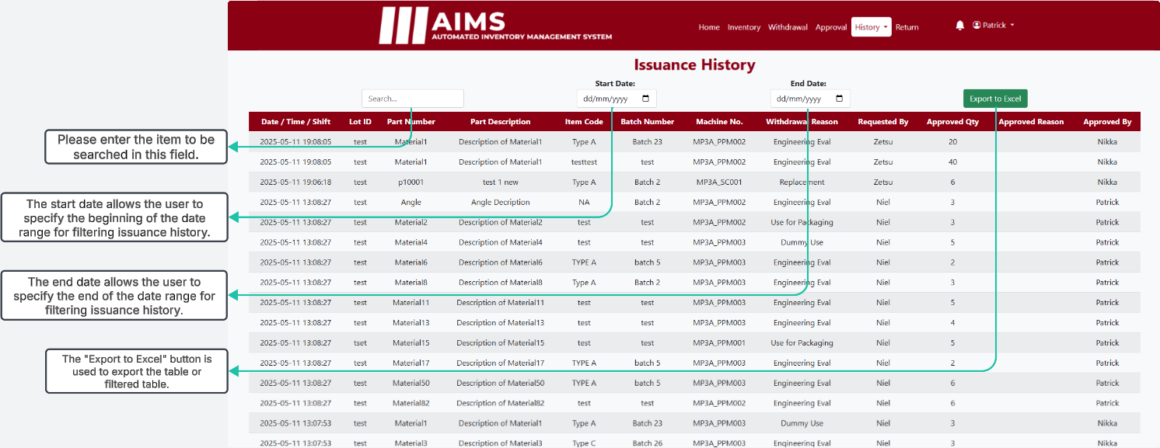
Supervisor / Kitting Issuance History

Slide 34
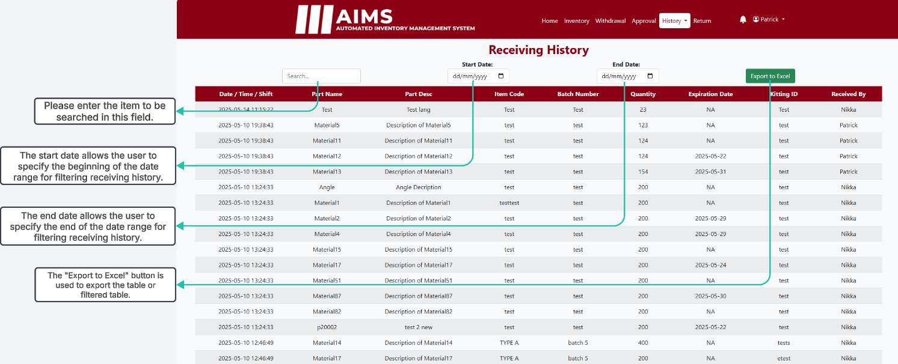
Supervisor / Kitting Receiving History

Slide 35
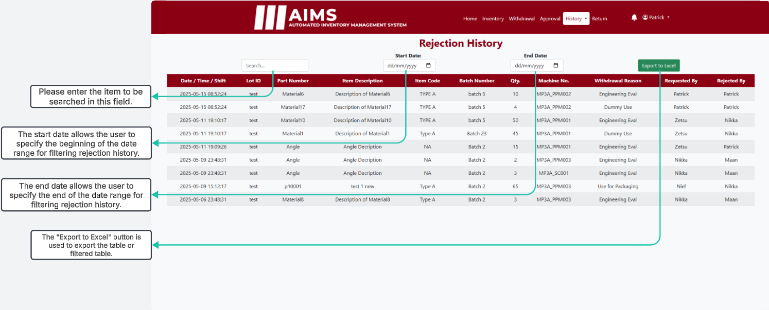
Supervisor / Kitting Rejection History

Slide 36
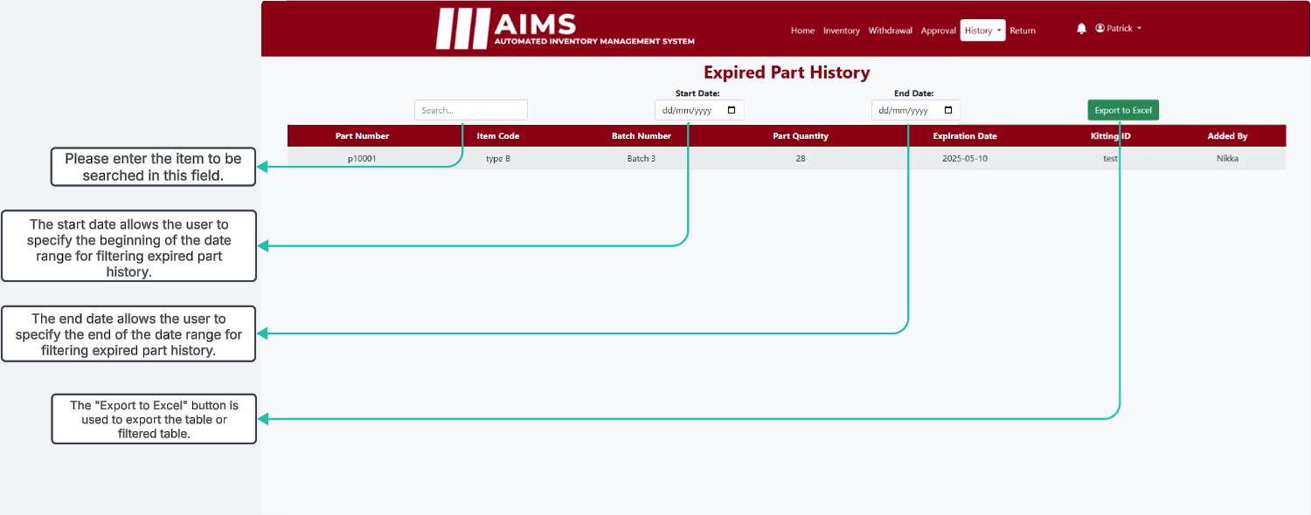
Supervisor / Kitting Expired Part History

Slide 37
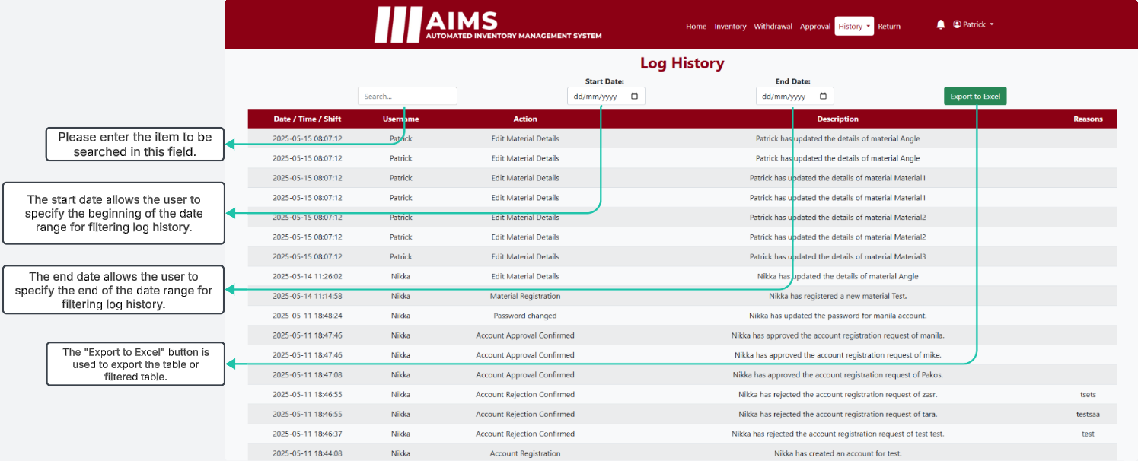
Supervisor / Kitting Log History

Slide 38
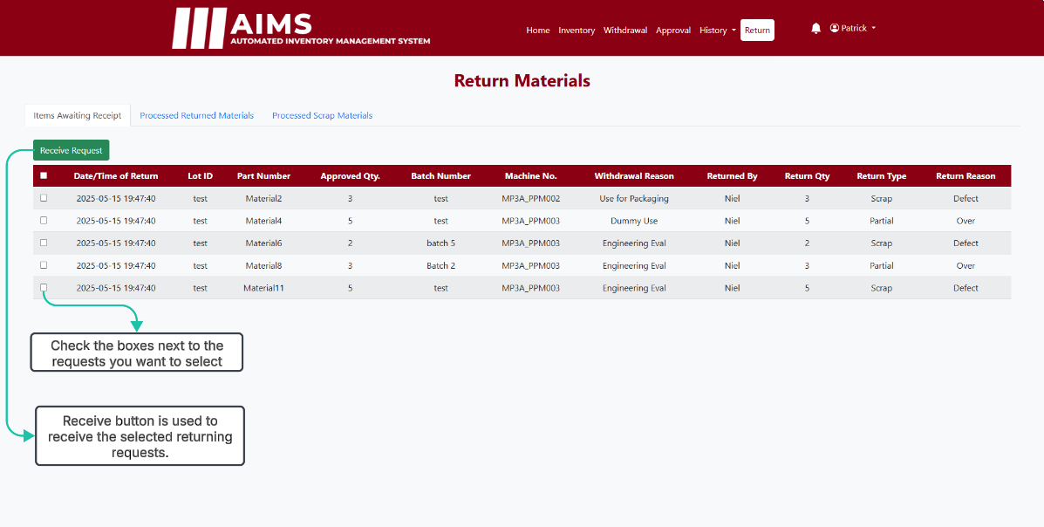
Supervisor / Kitting Scrap Awaiting Receipt

Slide 39
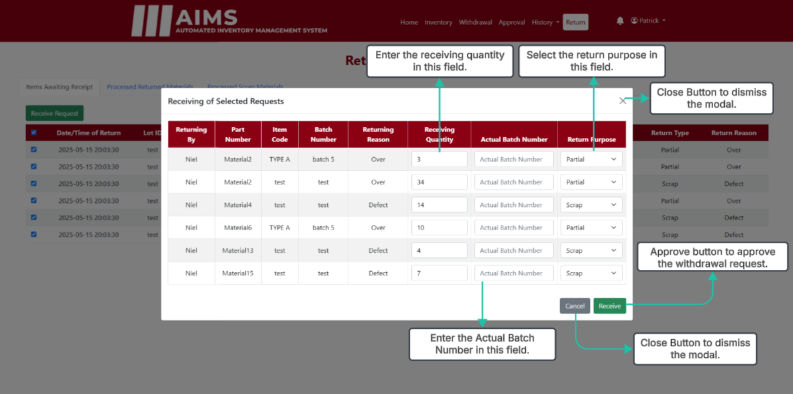
Supervisor / Kitting Scrap Awaiting Receipt

Slide 40
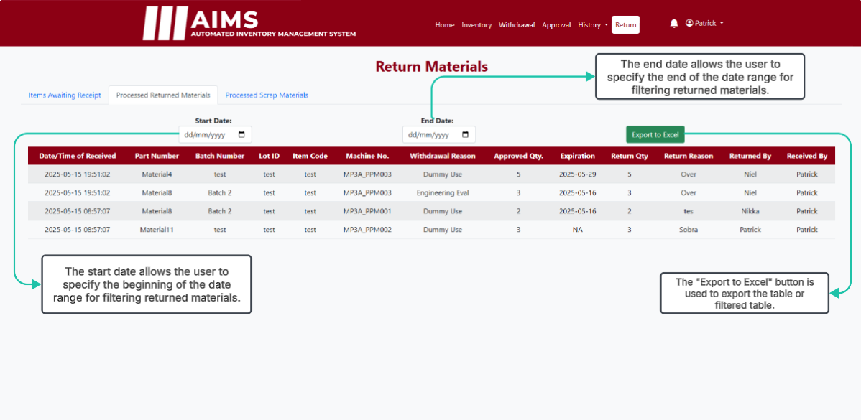
Supervisor / Kitting Processed Returned Items

Slide 41
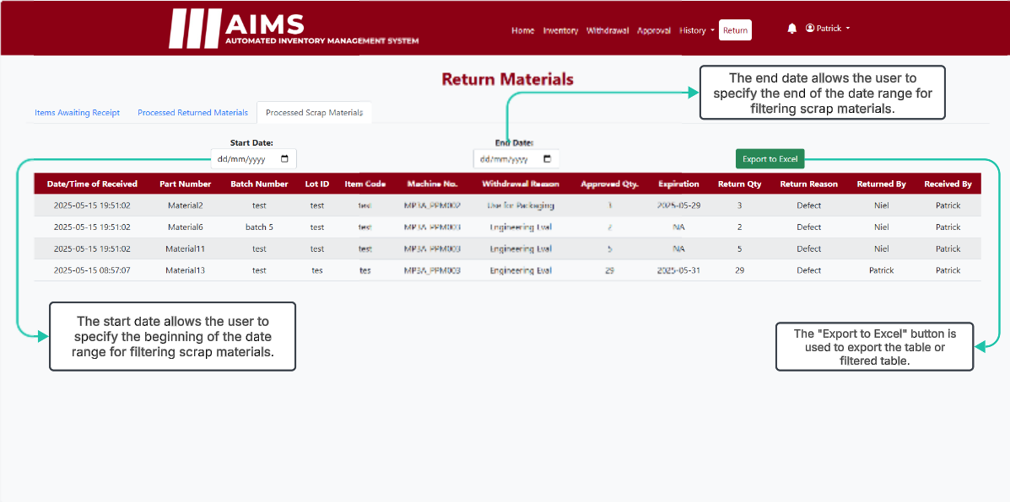
Supervisor / Kitting Processed Scrap Items

Slide 42
SUPERVISOR MODULE ONLY

Slide 43
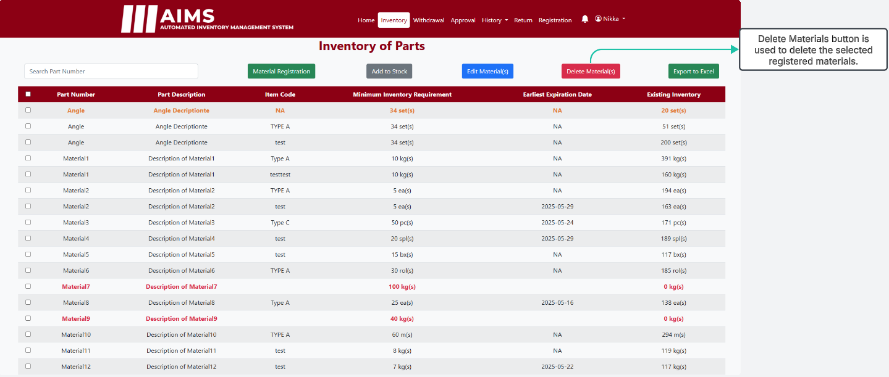
Supervisor Withdrawal

Slide 44
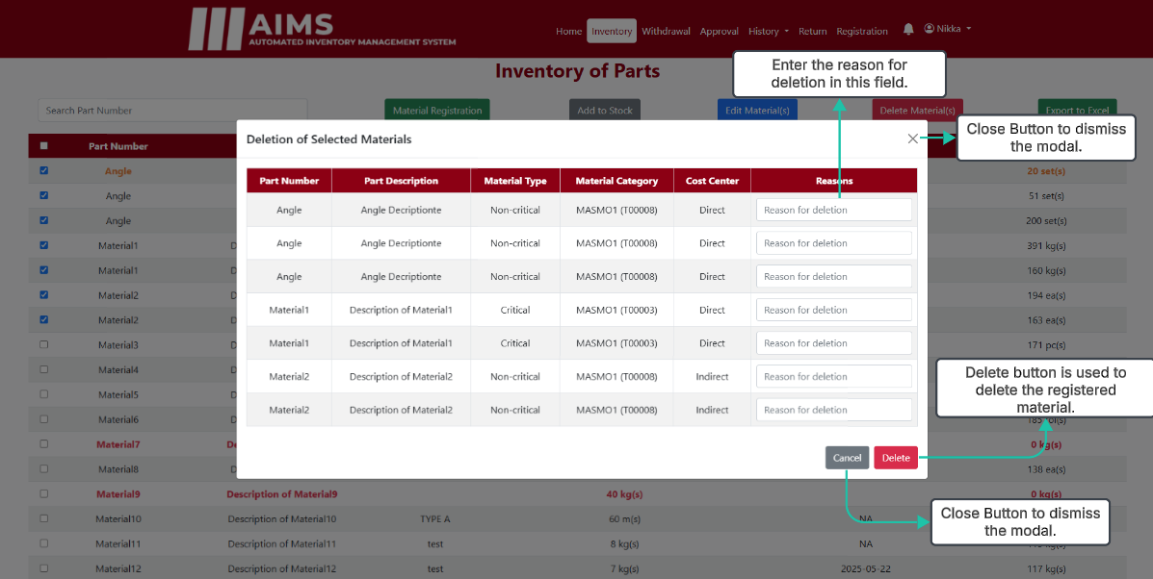
Supervisor Withdrawal (Delete Modal)

Slide 45
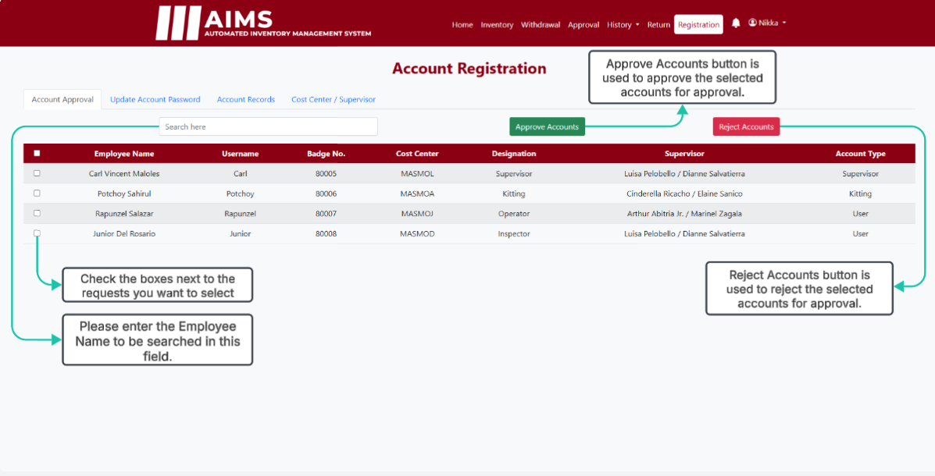
Supervisor Account Approval

Slide 46
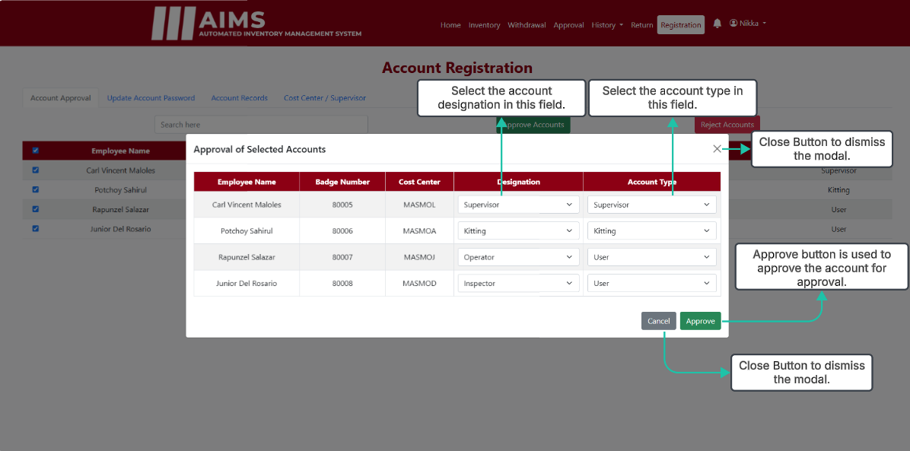
Supervisor Account Approval (Approval Modal)

Slide 47
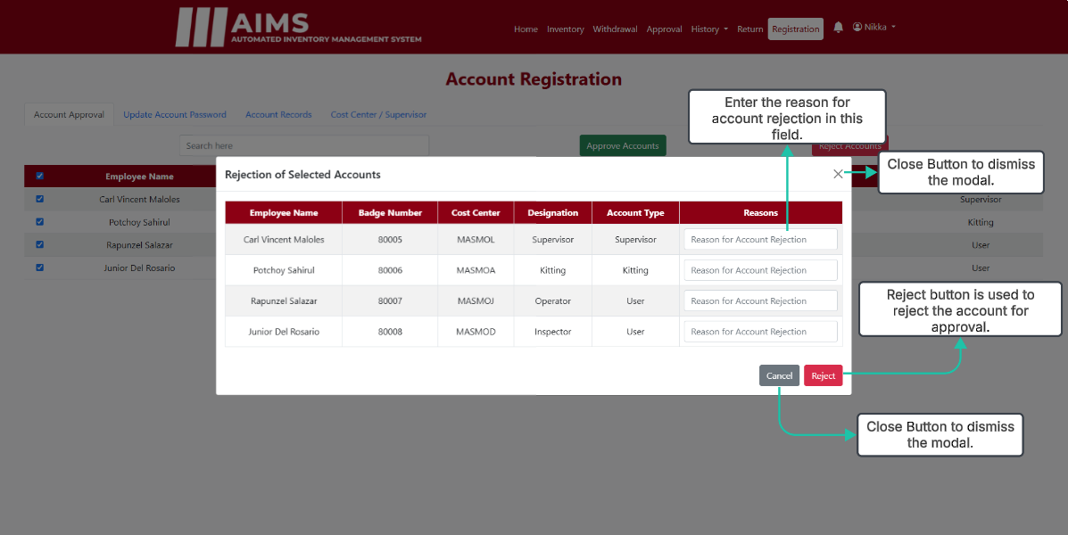
Supervisor Account Approval (Rejection Modal)

Slide 48
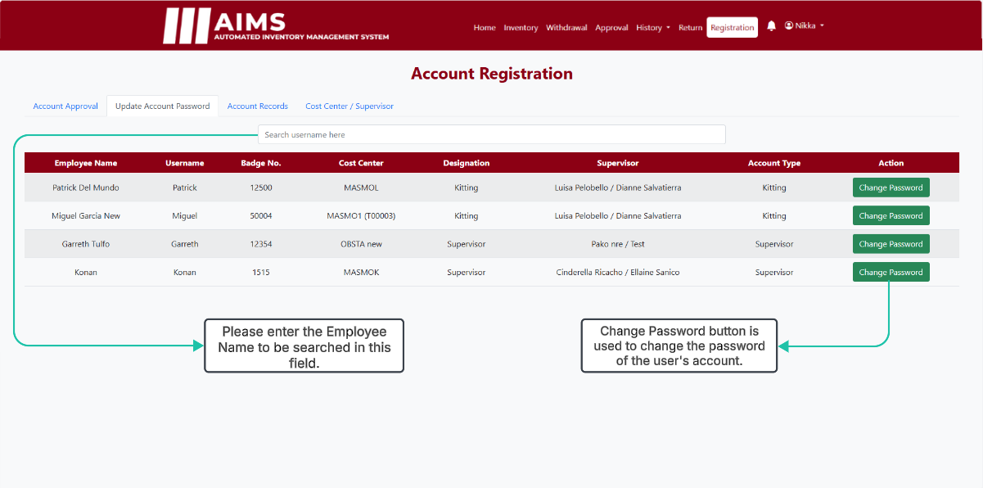
Supervisor Update Account Password

Slide 49
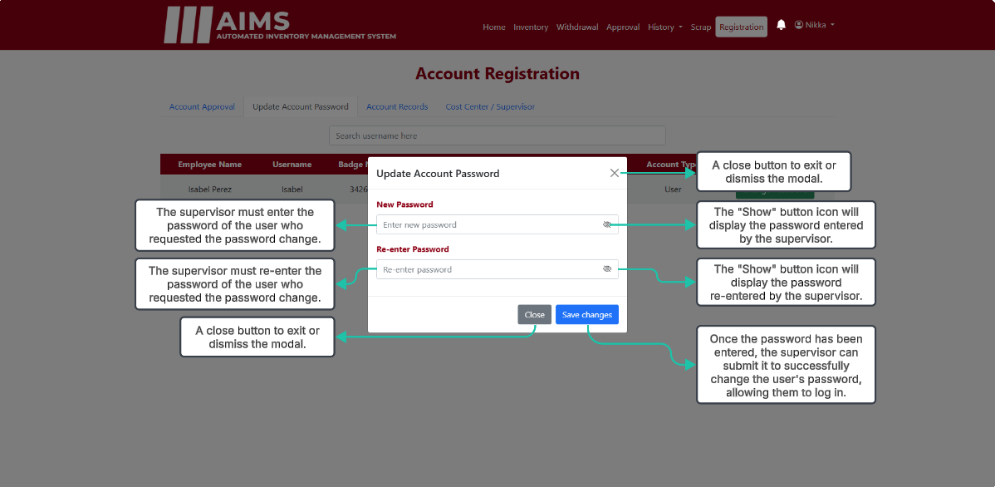
Supervisor Change Password

Slide 50
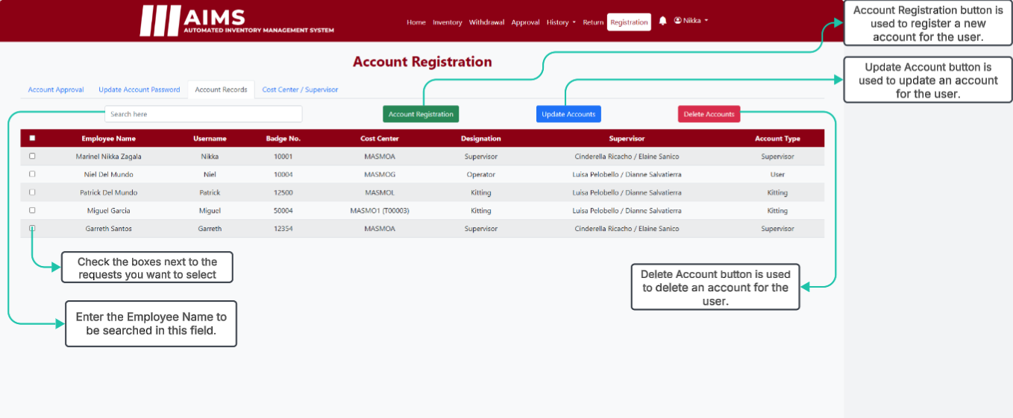
Supervisor Account Records

Slide 51
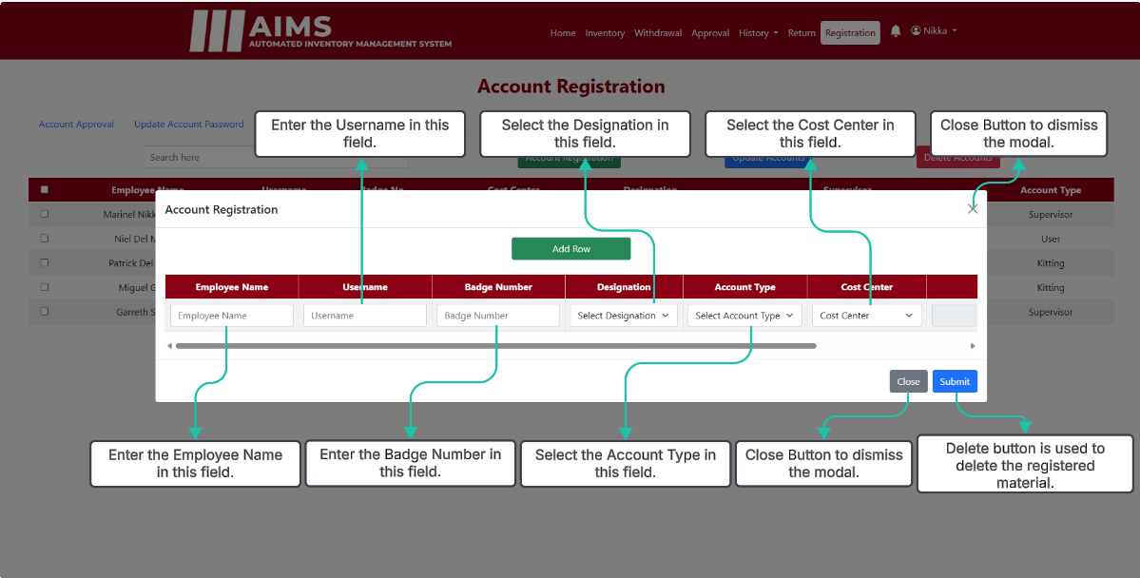
Supervisor Register Account (Registration)

Slide 52
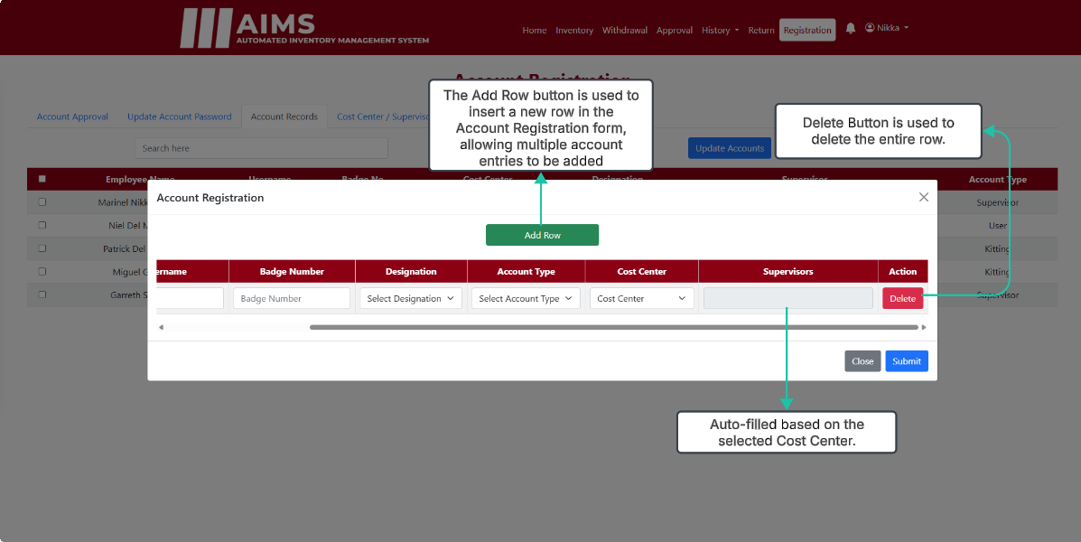
Supervisor Register Account (Registration)

Slide 53
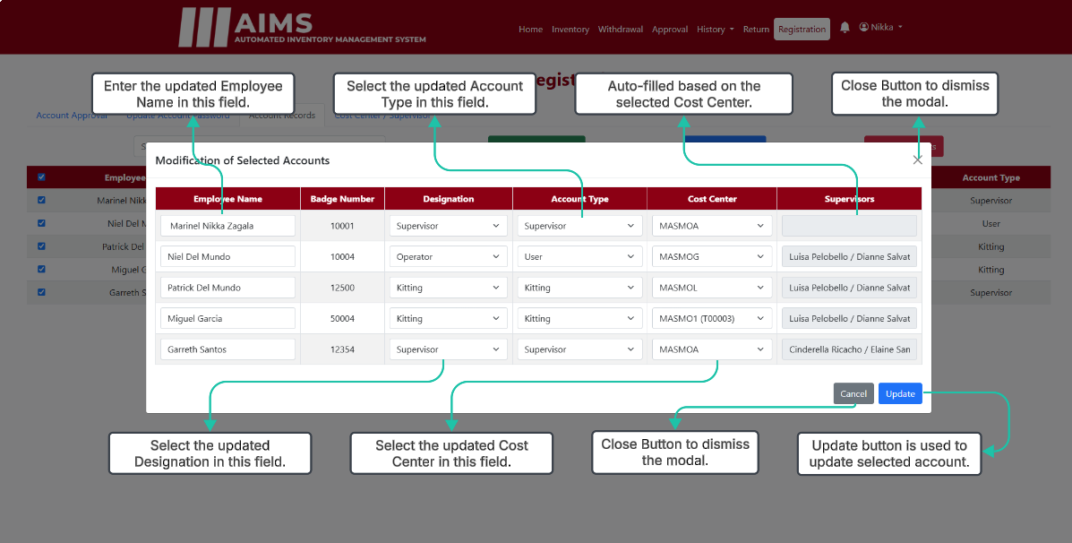
Supervisor Register Account (Modification)

Slide 54
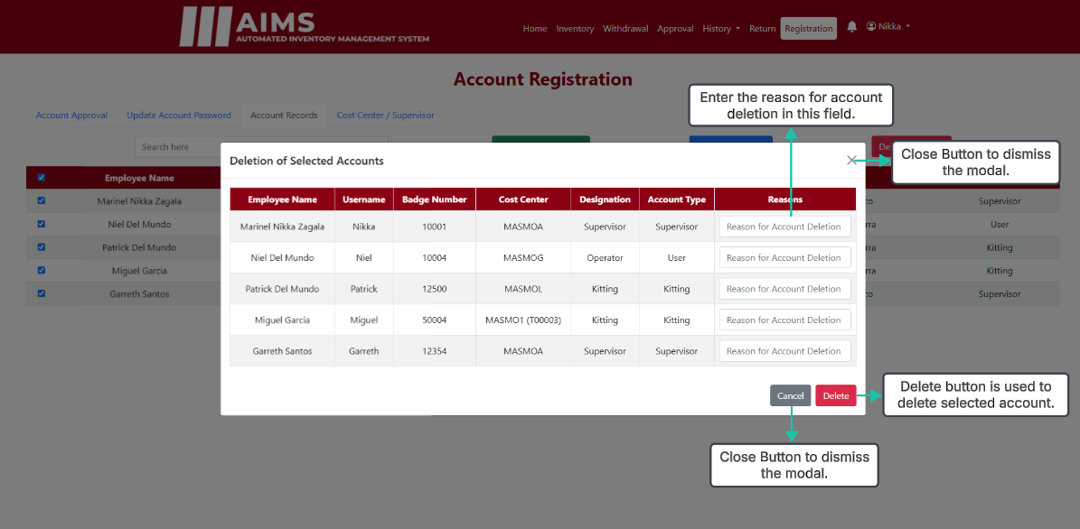
Supervisor Register Account (Deletion)

Slide 55

Supervisor Cost Center / Supervisor

Slide 56

Supervisor Cost Center Creation

Slide 57

Supervisor Cost Center Update Modal

Slide 58

Supervisor Cost Center Delete Modal

